Slide 1
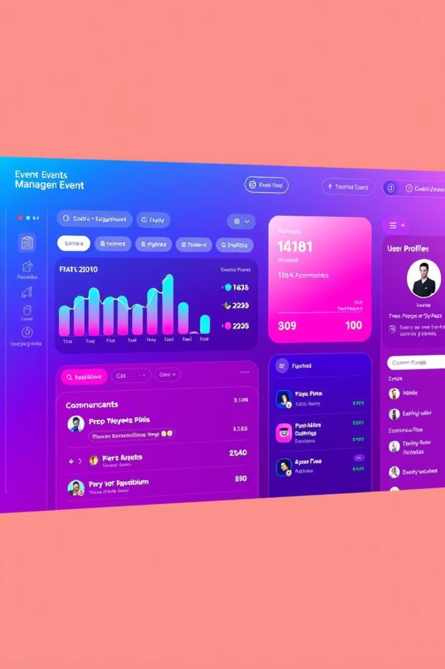
Event Management System..
Presented by:
1.K.Gowtham(2410030138)
2.Anish Jadhav(2410030188)
3.Mukesh(2410030320)
4.G.Kishore(2410030250)
5.P.Karthikeyan(2410030496)

Slide 2





Why Use a DBMS for Event Management?
Efficient Data Handling
Centralised Information
Manages complex event data for attendees, venues, vendors, and budgets.
All event details are consolidated for easy access and updates.
Minimised Errors
Real-time Insights
Structured design reduces redundancy and ensures data accuracy.
Enables instant tracking and reporting for informed decisions.

Slide 3

Core Database Design: Key Entities & Relationships
Key Entities
Relationships
Event: Stores ID, name, date, location.
A DBMS ensures data integrity and connectivity:
Attendee: Tracks ID, name, contact, linked to events.
One event links to many attendees and tasks.
Venue: Manages ID, name, capacity, availability.
Many-to-many relationship between events and vendors.
Vendor & Task: Services supplied; activities tracked.
A single venue can host multiple events.
Budget & Schedule: Financial planning; timelines.

Slide 4





Practical Features & Benefits
Attendee Management
Venue Booking
Vendor Coordination
Streamlines registration and seating arrangements.
Manages capacity and avoids scheduling conflicts efficiently.
Ensures smooth execution through task assignment.
Budget Control
Real-time Reporting
Tracks expenses for optimal cost efficiency.
Monitors progress and evaluates event success.

Slide 5
Conclusion: Transforming Event Planning with DBMS
A DBMS revolutionises event management by centralising data, reducing errors, and improving communication. It provides scalable solutions for any event type, empowering organisers with data-driven insights for impeccable execution.
By integrating a robust DBMS, event planners can:
Streamline operations: From attendee lists to vendor payments, everything is in one system.
Enhance collaboration: Real-time updates improve teamwork among stakeholders.
Ensure scalability: Manages multiple events, whether corporate, social, or academic.
Drive success: Data-driven decisions lead to flawless execution and superior outcomes.

